Slide 1

Stored Procedures
Asst.Prof.Dr.Derya BİRANT
328 - Web Based Windows Programming

Slide 2
Contents
1
What is a Stored Procedure?
2
Stored Procedure Benefits
3
Stored Procedure Examples

Slide 3
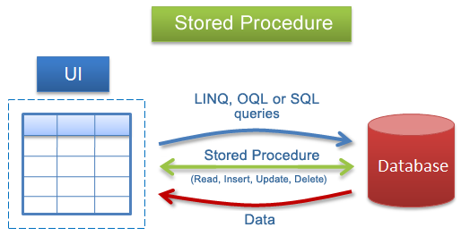
What is a Stored Procedure?
Stored Procedure is a batch of one or more SQL statements that are stored in the database.
Stored Procedures are similar to functions in that they are well-encapsulated blocks of logic that can accept data and return data.

Slide 4
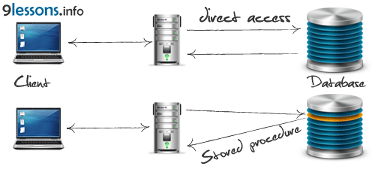
Stored Procedure Benefits
They are easier to maintain
They allow you to implement more secure database usage
They can improve performance

Slide 5
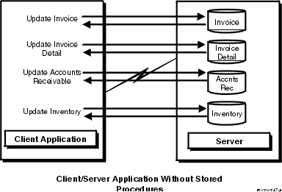
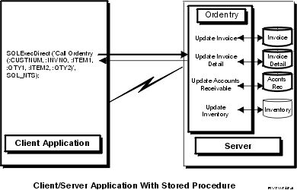
with – without Stored Procedure
this requires a minimum of eight messages between the server and the client
the communications traffic has been reduced to a single message pair.
the procedure can arrange to send back only the data that is absolutely required

Slide 6
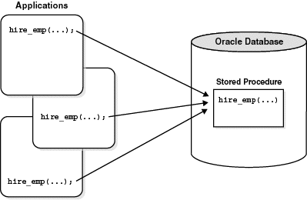
Stored Procedure Example

Slide 7
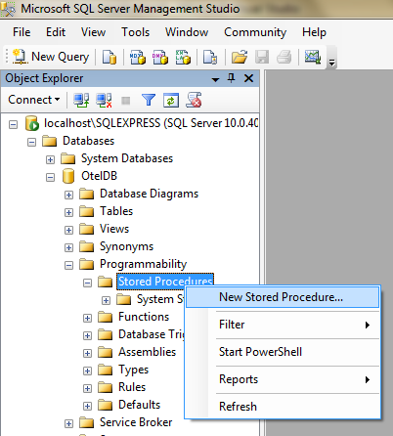
Creating New Stored Procedure

Slide 8
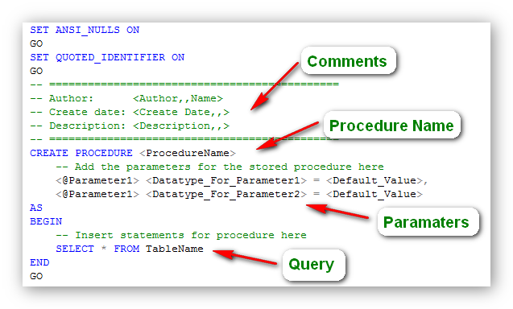
Creating a Stored Procedure

Slide 9
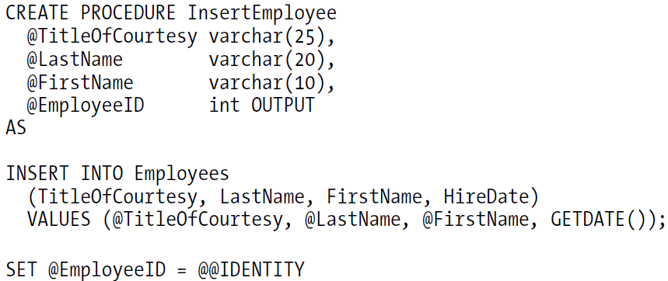
Creating Stored Procedure (Example)
A stored procedure for inserting a single record into the Employees table.
It returns the ID of the new record.

Slide 10


Calling Stored Procedure (Example)
…

Slide 11
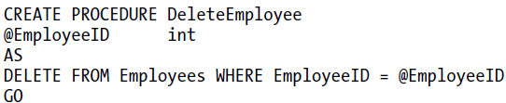
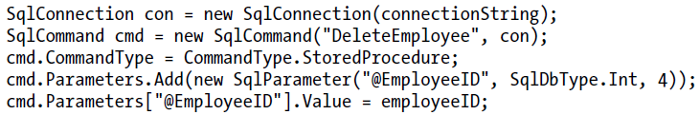

Creating Stored Procedure (Examples)

Slide 12
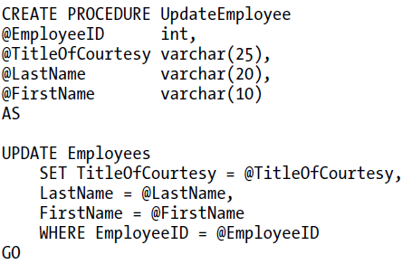
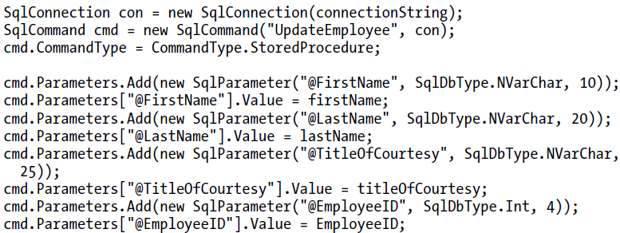


Slide 13




Stored Procedure Example

Slide 14

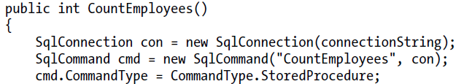

Stored Procedure Example

Slide 15
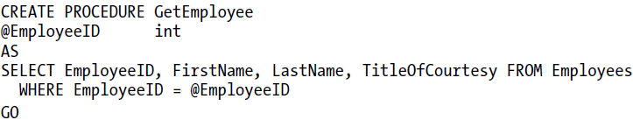
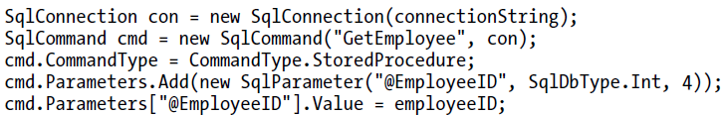

Stored Procedure Example

Slide 16
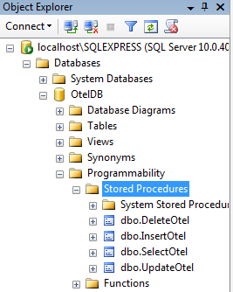
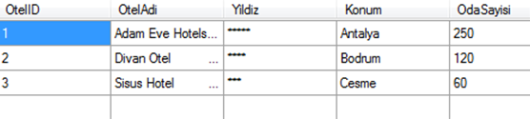
CREATE PROCEDURE InsertOtel
@OtelID int,
@OtelAdi nchar(30),
@Yildiz nchar(10),
@Konum nchar(20),
@OdaSayisi int
AS
INSERT INTO Oteller
VALUES (@OtelID, @OtelAdi, @Yildiz, @Konum, @OdaSayisi)
CREATE PROCEDURE DeleteOtel
@OtelID int
AS
DELETE FROM Oteller
WHERE OtelID = @OtelID
CREATE PROCEDURE UpdateOtel
@OtelID int,
@OtelAdi nchar(30),
@Yildiz nchar(10),
@Konum nchar(20),
@OdaSayisi int
AS
UPDATE Oteller
SET OtelAdi = @OtelAdi, Yildiz=@Yildiz, Konum=@Konum, OdaSayisi=@OdaSayisi
WHERE OtelID = @OtelID
CREATE PROCEDURE SelectOtel
AS
SELECT * FROM Oteller

Slide 17
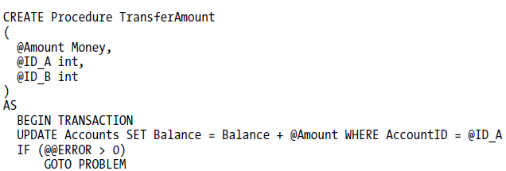


Transactions in Stored Procedures

Slide 18
Transactions in Stored Procedures
CREATE PROCEDURE Musteri_Ekleme
(
@MusteriNo as char(10),
@MusteriAdi as char(20),
@MusteriSoyadi as char(20),
@Adres as char(30),
@Tel as char(12)
)
AS
declare @number int
BEGIN TRANSACTION
select @number=COUNT(*)
from musteri
where (musterino=@MusteriNo)
if @number>0 goto on_error
INSERT INTO Musteri
(MusteriNo, MusteriAdi, MusteriSoyadi, Adres, Tel)
VALUES (@MusteriNo, @MusteriAdi, @MusteriSoyadi, @Adres, @Tel)
IF (@@ERROR <> 0) GOTO on_error
COMMIT TRANSACTION
RETURN
on_error:
ROLLBACK TRANSACTION
RETURN
GO

Slide 19
CREATE PROCEDURE InsertOtelwithTransaction
@OtelID int,
@OtelAdi nchar(30),
@Yildiz nchar(10),
@Konum nchar(20),
@OdaSayisi int
AS
declare @number int
BEGIN TRANSACTION
select @number=COUNT(*)
from Oteller
where (OtelID=@OtelID)
if @number>0 goto on_error
INSERT INTO Oteller
VALUES (@OtelID, @OtelAdi, @Yildiz, @Konum, @OdaSayisi)
IF (@@ERROR <> 0) GOTO on_error
COMMIT TRANSACTION
RETURN
on_error:
ROLLBACK TRANSACTION
RETURN

Slide 20
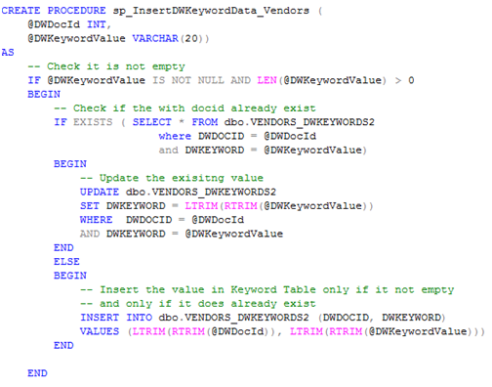
Example

Slide 21
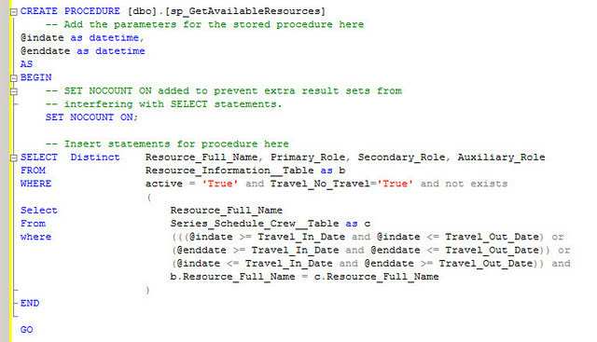
Example

Slide 22
See you next week!
Asst.Prof.Dr.Derya BİRANT
328 - Web Based Windows Programming

